Slide 1
Coaching Young Adults- The Gen Y Conundrum
B-J Mather, RFL

Slide 2
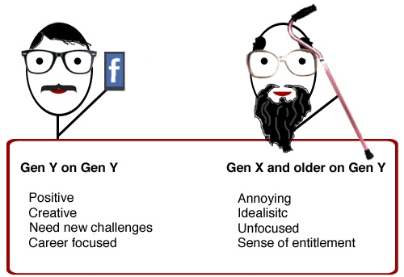
CHALLENGES OF GEN Y

Slide 4
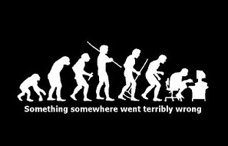

Slide 5
JOINT INTEGRITY
 |  | TOTAL NUMBER OF PLAYERS PASSING JOINT INTEGRITY PART 1 |  | TOTAL NUMBER OF PLAYERS PASSING JOINT INTEGRITY PART 2
 | LEVEL | 2011 | 2012 | 2011 | 2012
 | ACADEMY (39/33) | 39 (100%) | 24 (73%) | 32 (82%) | 27 (82%)
 | YOUTH (39/40) | 37 (95%) | 34 (85%) | 32 (82%) | 39 (98%)
 | TOTAL | 76 (97%) | 58 (80%) | 64 (82%) | 66 (90%)

Slide 6
FUNCTIONAL MOVEMENT
SQUAT
SINGLE LEG DIP (L+R)
HOP AND HOLD (L+R)
LEAP AND HOLD (L+R)

Slide 7
RECRUITMENT
Recruit from 13 SL Academies, 2 Championship Academies, 3 Regional Academies
Aligned to RFL 6 Panel Model- Tech, Tac, Mental, Physical, Movement and Lifestyle
Varying standards of delivery between clubs and environments.
Different focus of delivery and systems of development between clubs

Slide 8
IMPLICATIONS
Technical skills of players differ when they arrive with us.
Tactical awareness is at different stages
Mentally and emotionally the players are at different stages, due to internal and external factors.
Offer more ‘tools’ for the player to be able to cope with different situations.
Different methods of communication and practice. (VAK)
Comfortable in uncomfortable situations.
Player focussed, not player centred

Slide 9
CHALLENGES
COPING WITH DISAPPOINTMENT – set them up to fail...... and then recover. Training and Games
CONFIDENCE AND SELF BELIEF- different styles, players, coaches.
ENVIRONMENTAL PRESSURE- clubs, parents, self doubts. (Paras, Oz, Player/Parent education)
PLAYER CENTRED V PLAYER FOCUSSED –more access to better facilities, training, S&C. Sit back and take it, not work for it.

Slide 10
QUESTIONS ?
B-J Mather
bj.mather@rfl.uk.com
07540636515

